Slide 1
INFO6150 – FinalProject
By Yue Liu, Qiushi Zhang, Maqi Shi, Yibing Zhu

Slide 2
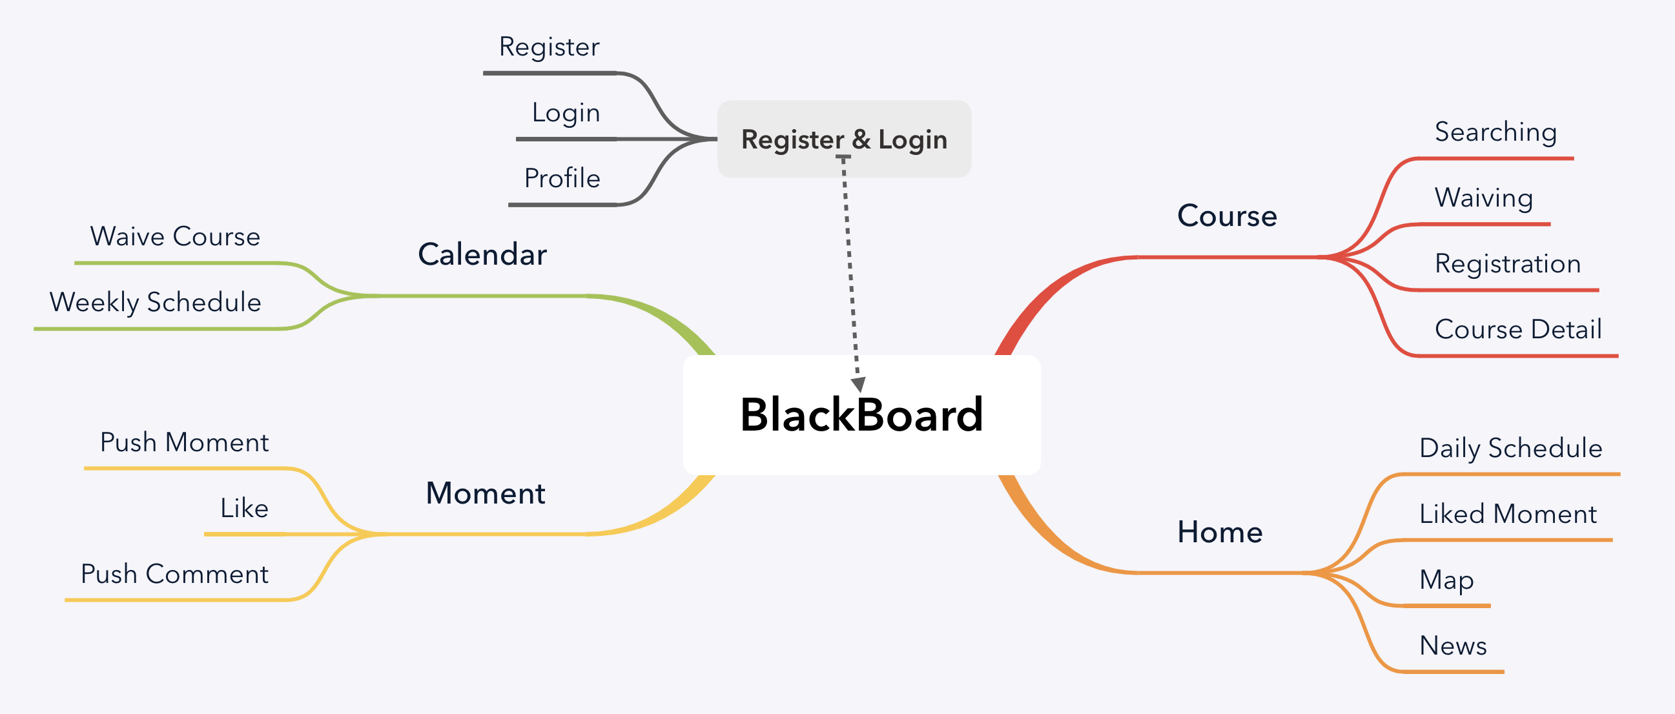

Slide 3
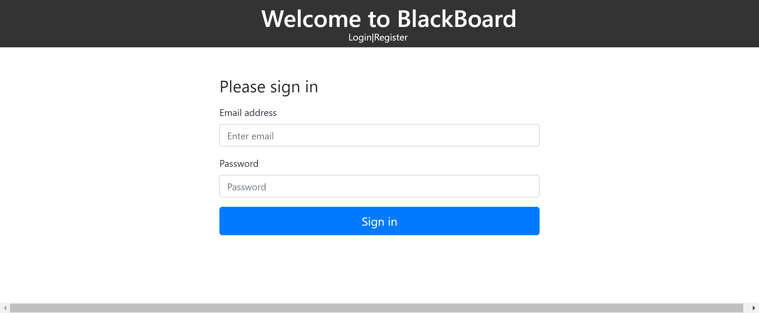
Login Page

Slide 4
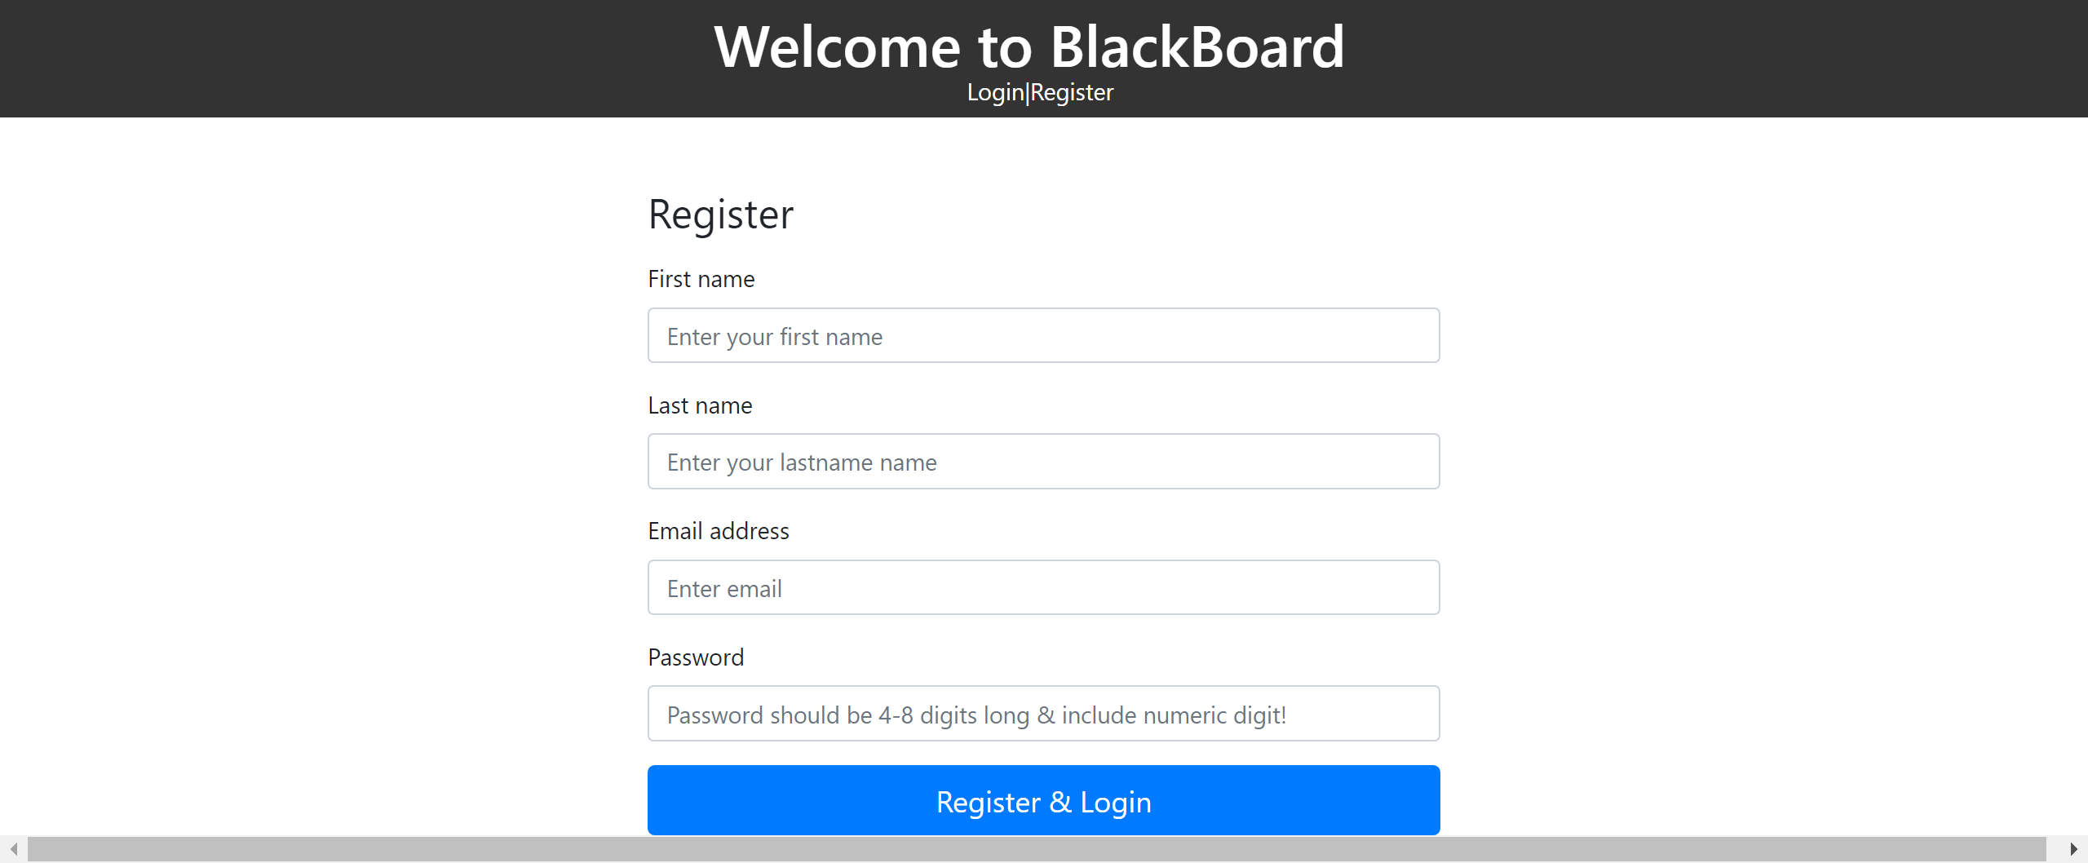
Registration Page

Slide 5
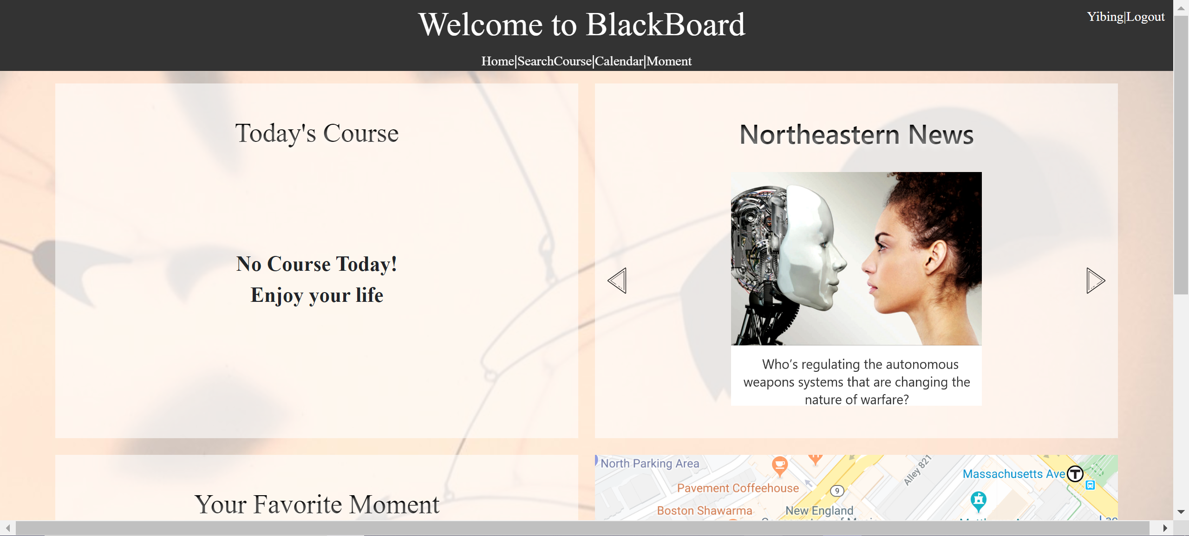
Home Page

Slide 6
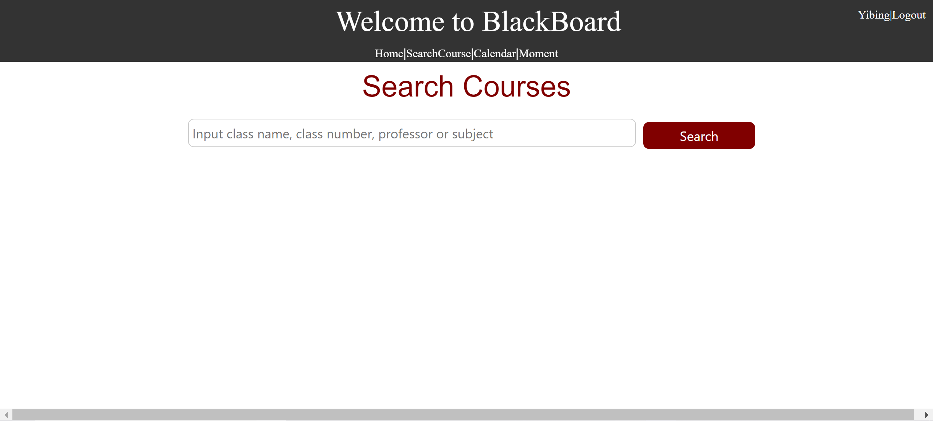
Search Page

Slide 7
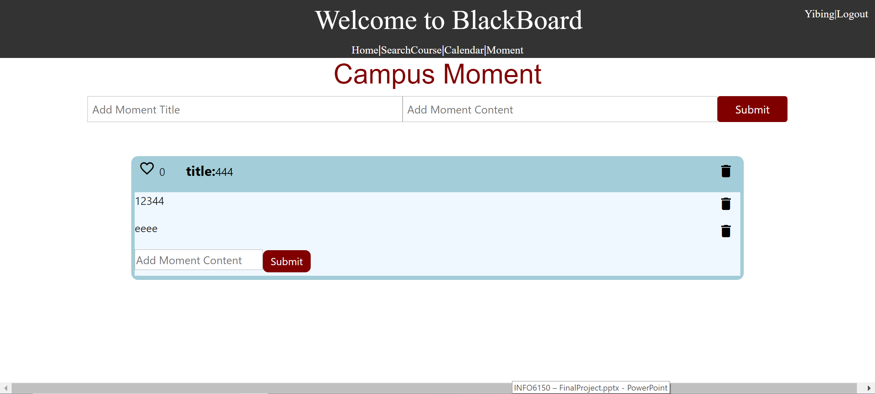
Moment Page

Slide 8
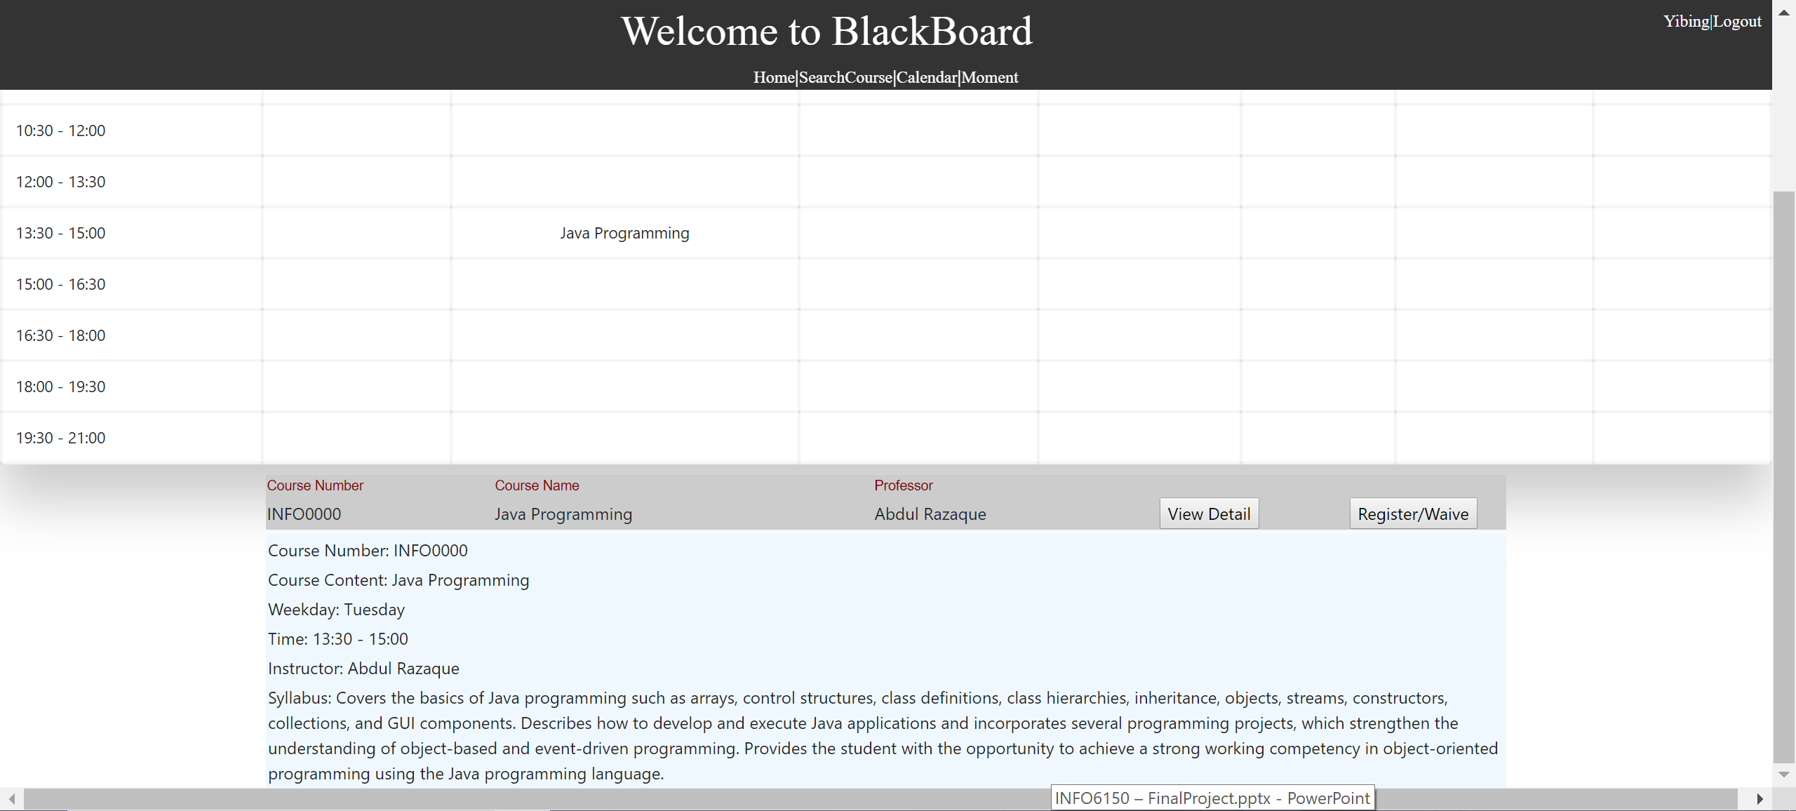
Calendar Page

